Slide 1

Movie Database
TEAM 4
By Branden Lee, Anh Truong, Alexander Morfin, and Michael Wu
Notes:
Team name and team member
Introduction–a short summary describing the project application
Data Diagram
Flow Chart
A short description of each team member's assignment
Hash function (the actual code) , and pseudocode and examples with typical data, showing collision resolution

Slide 2
Movie Database Features
The Movie Database enables you to search any movie online and quickly search it offline.
Search online for movies and save them to local database
Search local database by title, year, rating, and genre
Import/export local database from/to file
Add/Delete custom movie entries
Print out indented tree of movie titles
Show data in the hash table
Display efficiency of various operations

Slide 3
Role Description
Michael | Anh | Alex | Brad | Assignment
 |  |  | X | Unit 1: Team Coordinator
 | X |  |  | Unit 2: BST
 |  |  | X | Unit 3: Hashed Table
 |  | X |  | Unit 4: Standard IO
X |  |  |  | Unit 5: File IO
 |  |  | X | Unit 6: Data Record
 |  |  | X | Unit 7: HTTP requests
X |  |  |  | Test Plan: Options and data so that anyone could use it to demonstrate the project. Presentation Outline: Activity, duration, etc.
X | X | X | X | Project Documentation: soft copy of all files
Notes:
(1). Add new data
(2). Delete data
(3). Find and display one data record using the primary key
(4). List data in hash table sequence
(5). List data in key sequence (sorted)
(6). Print indented tree
(7). Efficiency
(8). <Team choice menu option>
(9). Quit

Slide 4
Data Structure Diagram
Count
ArrSize
Hash Table
BST
Hash Table[0]
Title
Hash Table[1]
Year
.
Rating
.
Genre
.
Hash Table[n]

Slide 5
User Interaction Flow
Web Returns Movies
User Searches Web For Movie Title
Results Displayed. Movies cached into local database
Local Movie Database
User Searches Local Database for Movie Title
Results Displayed.

Slide 6
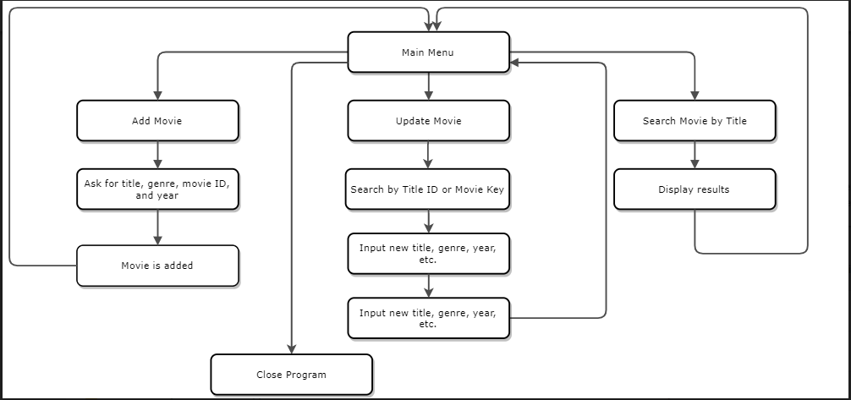
Structure Chart (shortened)

Slide 7
HTTP requests
Server
Client
Internet Movie Database API
Movie Database Program
HTTP GET movies matching “Spider Man”
HTTP response JSON encoded data

Slide 8
File IO
FileIO::mainStorageToFile (MainStorage *mainStoragePtr, std::string filePath)
FilePath
Local Movie Database
FilePath
FileIO::fileToMainStorage (MainStorage *mainStoragePtr, std::string filePath)
Local Movie Database

Slide 9
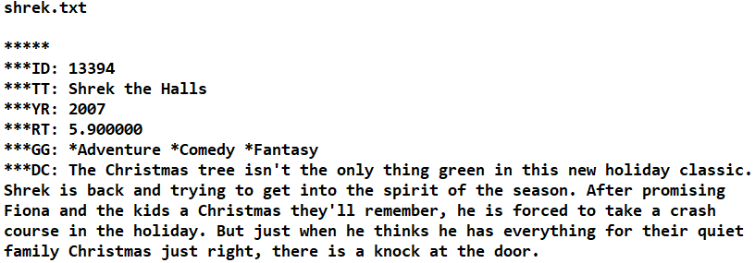
File IO

Slide 10
Movie Insertion
Movie Node:
ID | Title | Year | Key | Genres
559 | Spider-Man 3 | 2007 | Spider_Man_3_2007 | Fantasy, Action, Adventure
TitleIndexTree[10]
YearTree
Hash
Table
GenreIndexTree[2]
iron
2002
drama
home
spider
1999
2007
comedy
fantasy
Notes:
When a movie is inserted into the

Slide 11
Movie Title Indexing
Each word indexed in a BST For example:
A Movie Title, With 中文繁體 Characters
movie title with characters
Title Linked List:
movie | title | with | characters
Tree #1
Tree #2
Tree #3
Tree #4
example
text
igloo
job
apple
movie
tastes
title
great
with
characters
kangaroo

Slide 12
Movie Title Searching
Search Query:
thor
Tree #1
Tree #2
Tree #3
Tree #4
thor
star
igloo
job
batman
movie
begins
thor
great
inception
house
kangaroo
Results:
Results:
Final Results:
SQL Equivalent
Union of Search
Search Word | ID
thor | 5
thor | 7
Search Word | ID
thor | 5
thor | 9
Search Word | ID
thor | 5
thor | 7
thor | 9
Notes:
In this example we show a single search query containing a single search term being searched in each of the ten (10) BSTs. In the example, Tree #1 and #2 return a resultset that have a union performed on them to return the final result set.

Slide 13
Hash Table
Implemented as a buckets with separate chaining with linked lists
Movie Nodes
(heap)
Buckets
Linked List Nodes
X | spider_man_2002
Keys
001
002
...
014
015
016
...
159
the_flash_2014
thor_2011
spider_man_2002
superman_returns_2006
the_avengers_2012
X | thor_2011
X | superman_returns_2006
 | the_flash_2014
X | the_avengers_2012
Notes:
The hash table is implemented as buckets with separate chaining using linked lists. In a collision the first inserted movie is at the first position in the bucket linked list and the collided movie is pushed back.

Slide 14
Hashing Algorithm
#define A 54059 /* a prime */
#define B 76963 /* another prime */
#define FIRSTH 37 /* also prime */
unsigned int StringHelper::hashStr (std::string str, unsigned int size)
{
const char * s = new char[str.length () + 1];
s = str.c_str ();
unsigned int h = FIRSTH;
while (*s)
{
h = (h * A) ^ (s[0] * B);
s++;
}
return h % size;
}
Notes:
We use prime number multiplication in the hsah function to reduce hash table collisions.

Slide 15
Demo....

